Slide 1

Green Pace
Security Policy Presentation
Developer: Douglas Rowland

Slide 2

OVERVIEW: DEFENSE IN DEPTH
The Green Pace Security Policy standardizes secure coding practices to reduce risks and ensure compliance. By integrating security into the DevSecOps pipeline, we strengthen system resilience through automated enforcement and layered protection.

Slide 3
THREATS MATRIX
SQL Injection: Attackers may inject malicious queries, compromising data integrity Buffer Overflows: Can be exploited for remote code execution | Memory Corruption: Can lead to crashes, privilege escalation, or data leaks Insecure Authentication: Weak authentication can expose sensitive data
Hardcoded Credentials: A risk but less likely if proper secret management is enforced Deprecated Functions: Legacy code may introduce vulnerabilities but has limited impact if updated. | Race Conditions: Rare but can lead to unpredictable behavior and security flaws Side-Channel Attacks: Less common but still a concern for cryptographic operations

Slide 4
10 PRINCIPLES
Validate Input Data: Prevents injection attacks and ensures data integrity. (STD-001-CPP, STD-002-CPP)
Heed Compiler Warnings – Helps catch potential issues early. (STD-005-CPP, STD-006-CPP)
Architect and Design for Security – Security should be built into the system from the start. (All standards)
Keep It Simple – Complexity introduces security risks. (STD-003-CPP, STD-008-CPP)
Default Deny – Restrict access by default. (STD-004-CPP, STD-009-CPP)
Principle of Least Privilege – Limit access to only what is necessary. (STD-010-CPP)
Sanitize Data Sent to Other Systems – Prevents injection and formatting issues. (STD-003-CPP, STD-004-CPP)
Practice Defense in Depth – Multiple layers of security reduce risk. (All standards)
Use Effective Quality Assurance – Testing and code reviews catch vulnerabilities early. (STD-006-CPP, STD-007-CPP)
Adopt Secure Coding Standards – Follow industry best practices to minimize risks. (All standards)

Slide 5
CODING STANDARDS
Validate Input Length (STD-001-CPP) – Prevents buffer overflows and memory corruption.
Validate Data Values (STD-002-CPP) – Ensures proper input validation to prevent crashes or logic errors.
Ensure String Correctness (STD-003-CPP) – Protects against buffer overflows and injection attacks.
Prevent SQL Injection (STD-004-CPP) – Uses parameterized queries to prevent database compromise.
Ensure Memory Protection (STD-005-CPP) – Avoids memory leaks, dangling pointers, and buffer overruns.
Use Assertions to Verify Assumptions (STD-006-CPP) – Helps catch logic errors early.
Use Exceptions for Error Handling (STD-007-CPP) – Provides structured error handling.
Avoid Dangerous Functions (STD-008-CPP) – Replaces unsafe C functions like ‘gets()’ and ‘strcpy()’
Use Secure Random Number Generation (STD-009-CPP) – Prevents predictable security flaws.
Avoid Hardcoded Sensitive Data (STD-010-CPP) – Ensures credentials and keys are stored securely.
Prioritization:
High Priority: SQL Injection, Memory Protection, and Hardcoded Credentials are critical because they can lead to severe data breaches.
Medium Priority: Input Validation, String Correctness, and Secure Random Number Generation are essential but less immediate threats.
Lower Priority: Assertions and Error Handling improve security but are not direct security threats.

Slide 6
ENCRYPTION POLICIES
Encryption in Flight: Protects data as it moves over networks using TLS (Transport Layer Security) to prevent interception.
Encryption at Rest: Ensures stored data is protected using AES-256 encryption to prevent unauthorized access.
Encryption in Use: Secures data while being processed using memory encryption techniques like Intel SGX or homomorphic encryption.

Slide 7
TRIPLE-A POLICIES
Authentication: Requires multi-factor authentication (MFA) to verify user identity before granting access.
Authorization: Implements role-based access control (RBAC) to limit permissions based on user roles.
Accounting: Logs user activity, including logins, data access, and system changes, for auditing and compliance.

Slide 8
Unit Testing
[Identify the coding vulnerability you chose to test. Include four to six mixed tests for positive and negative results. Include a slide for each test. Use the question for the test as the title. Show the results.]

Slide 9
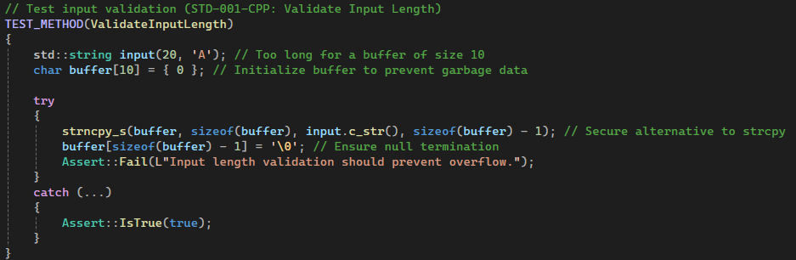
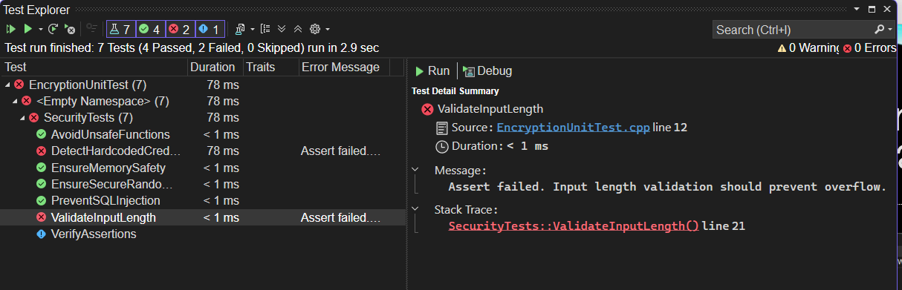
Unit Test: Does Input Validation Prevent Buffer Overflow?
This test checks if input validation correctly prevents buffer overflows. The test attempted to write a string larger than the allocated buffer, and the failure confirms that validation is missing or insufficient.

Slide 10
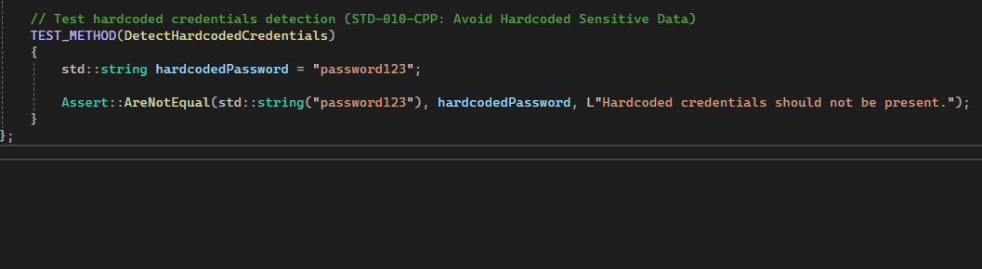
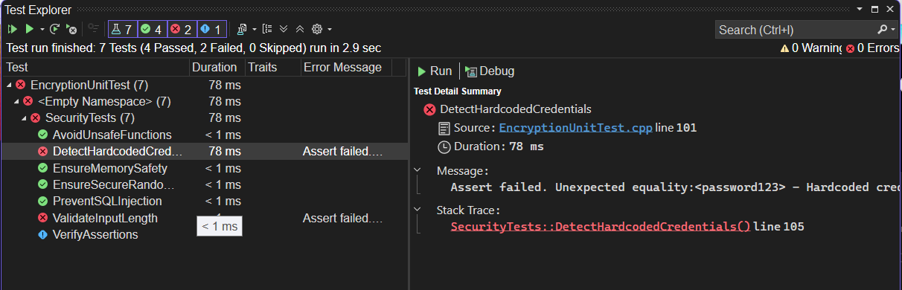
Unit Test: Are Hardcoded Credentials Being Used?
This test checks if hardcoded sensitive data (like passwords) exist in the code. Hardcoded credentials are a major security risk because they can be exploited if exposed in source code repositories

Slide 11
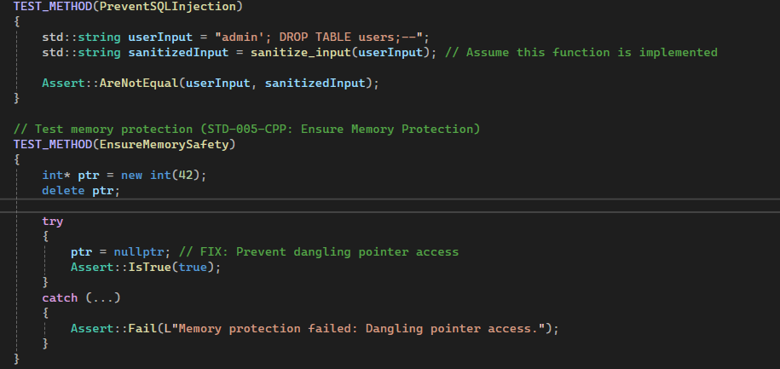
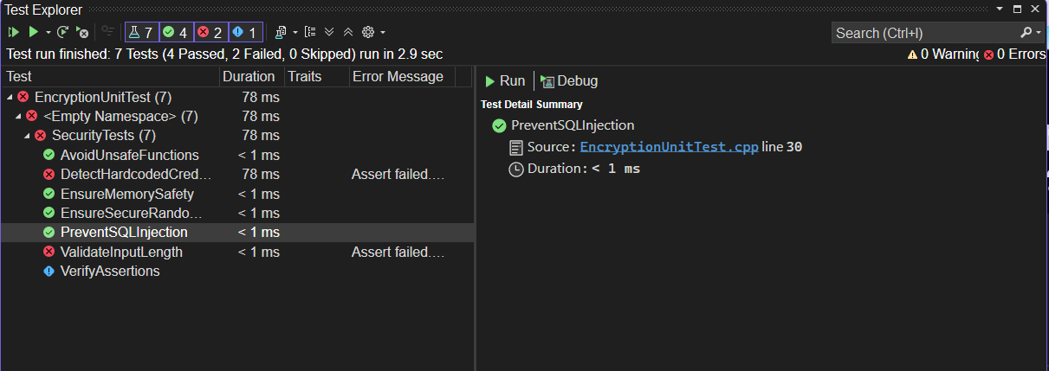
Unit Test: Is SQL Injection Prevented?
This test ensures that user input is sanitized before being used in an SQL query. SQL injection is one of the most dangerous web security risks and can compromise entire databases.

Slide 12
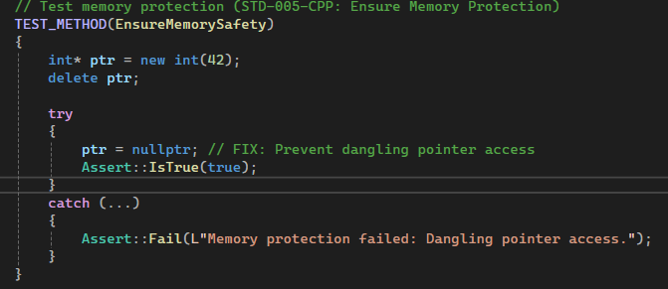
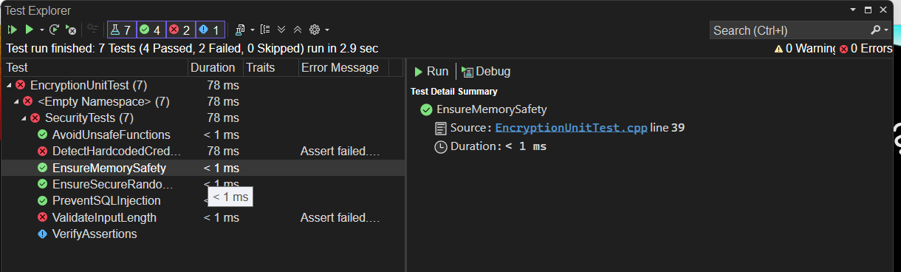
Unit Test: Is Memory Access Safe?
This test checks if memory is being accessed correctly after deallocation. Improper memory handling can lead to crashes, undefined behavior, or security vulnerabilities.

Slide 13
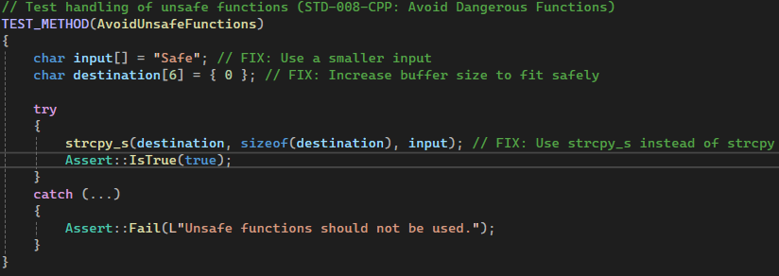
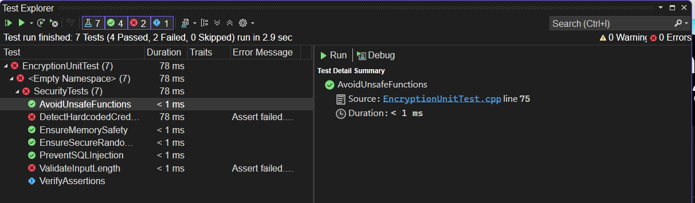
Unit Test: Are Unsafe Functions Avoided?
This test checks whether unsafe C functions like ‘strcpy()’ are avoided. Functions like ‘strcpy()’ do not perform bounds checking, leading to buffer overflows and security vulnerabilities.

Slide 14

AUTOMATION SUMMARY

Slide 15
TOOLS
The DevSecOps pipeline integrates security at every stage of development, ensuring vulnerabilities are identified and mitigated early. Automated security testing, monitoring, and response mechanisms help maintain a secure and stable environment.
Various security tools enhance automation across the pipeline. Static Application Security Testing (SAST) tools scan source code for vulnerabilities during development, while Dynamic Application Security Testing (DAST) tools detect runtime threats in pre-production. Software Composition Analysis (SCA) ensures third-party dependencies are secure, and Intrusion Detection Systems (IDS) monitor production for anomalies. These tools help enforce security best practices, detect risks early, and respond to threats efficiently.

Slide 16
RISKS AND BENEFITS
Problems & Risks Delaying security measures increases exposure to vulnerabilities, risking data breaches, system downtime, and compliance violations. A reactive approach results in higher costs and damage control efforts.
Solutions & Benefits Implementing proactive security strengthens defenses, reduces attack surfaces, and ensures regulatory compliance. Automating security checks within DevSecOps minimizes human error and improves efficiency.
Strategic Gaps & Next Steps The strategy must ensure continuous monitoring and rapid response to threats. Investing in penetration testing, automated security tools, and ongoing employee training will help maintain a resilient security posture.

Slide 17
RECOMMENDATIONS
Identified Gaps in the Security Policy:
Lack of Real-Time Threat Detection: The policy should integrate continuous monitoring tools to detect and respond to threats in real time.
Limited User Awareness & Training: Regular security training sessions for developers and employees can reduce human-related security risks.
Inadequate Secure Coding Enforcement: Implementing automated security linting tools in CI/CD pipelines will enforce best coding practices.
Absence of Incident Response Strategy: A structured incident response plan should be established to minimize damage and ensure rapid recovery.

Slide 18
CONCLUSIONS
To prevent future security risks, the following standards should be adopted:
OWASP Secure Coding Practices – Ensures applications follow best practices to mitigate common vulnerabilities.
NIST Cybersecurity Framework – Provides guidelines for risk assessment and proactive security management.
CWE/SANS Top 25 – Identifies the most dangerous software weaknesses to prevent high-impact vulnerabilities.
Zero Trust Architecture – Restricts access based on verification instead of assumed trust, reducing attack surfaces.
Continuous Security Testing – Integrating security scanning in CI/CD pipelines ensures vulnerabilities are detected early.

Slide 19
REFERENCES
Amazon Web Services. (n.d.). What is DevSecOps?. Retrieved from https://aws.amazon.com/what-is/devsecops/
Department of Defense Chief Information Office. (2021). DevSecOps fundamentals guidebook: DevSecOps tools & activities (Version 2.0).Retrieved from https://dodcio.defense.gov/Portals/0/Documents/Library/DevSecOpsT ools-ActivitiesGuidebook.pdf
Microsoft Azure. (n.d.). DevSecOps solutions. Retrieved from https://azure.microsoft.com/en-us/solutions/devsecops

